Slide 1

Introduction to Bootstrap 5
By Group-3
Binayak Purohit

Slide 2
What is Bootstrap?
Bootstrap is a frontend web designing toolkit.
Bootstrap is the most popular HTML, CSS, and JavaScript framework for developing responsive, mobile-first web sites.
It is an open source and free to use development framework.

Slide 3
What is responsive web design?
Responsive web design is an approach to web design that ensures that a website looks and functions well on all devices, including desktops, laptops, tablets, and mobile phone.
A responsive website is designed to adapt to the size of the user's device, so the website's layout and content will adjust accordingly.
By implementing responsive design, you can improve your website's user experience, increase your website's mobile-friendliness, and improve your website's search engine ranking.

Slide 4
Two ways of including bootstrap in your project.
Download Bootstrap from getbootstrap.com
If you want to download and host Bootstrap yourself, go to getbootstrap.com, and follow the instructions there.
Include Bootstrap from a CDN
If you don't want to download and host Bootstrap yourself, you can include it from a CDN (Content Delivery Network).
You can find the link for the same in getbootstrap.com.

Slide 5
Create web pages with Bootstrap
Add the link to the downloadable bootstrap.css file or the CDN in the head section of html.
<link rel="stylesheet" href="CSS/bootstrap-5.3.0/css/bootstrap.css">
(OR)
<link href="https://cdn.jsdelivr.net/npm/bootstrap@5.3.0-alpha3/dist/css/bootstrap.min.css" rel="stylesheet">

Slide 6
Container
Bootstrap requires a containing element to wrap site contents together.
The .container class provides a responsive fixed width container.
The .container-fluid class provides a full width container, spanning the entire width of the viewport.

Slide 7
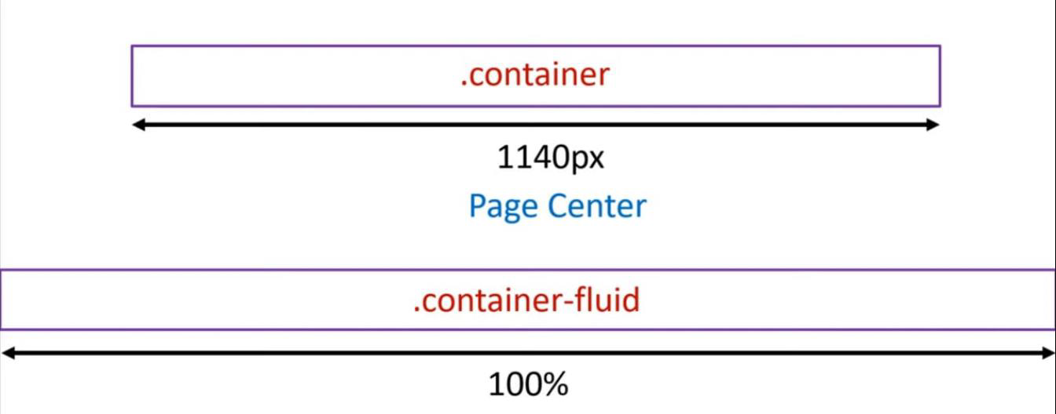
Container
Image

Slide 8
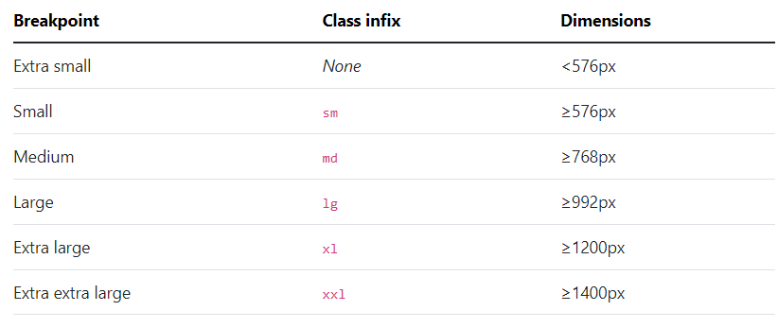
Breakpoints (grid breakpoints)
Bootstrap includes six default breakpoints, sometimes referred to as grid tiers, for building responsively.

Slide 9
Bootstrap Grids
Use our powerful mobile-first flexbox grid to build layouts of all shapes and sizes thanks to a twelve column system, six default responsive tiers, and dozens of predefined classes.
Bootstrap grid system allows a .row to have 12 columns and 6 different breakpoints such as (none, sm, md, lg, xl, xxl).
<div class="col-md-12">Span 12 columns</div>
OR
<div class="col-md-6">Span 6</div>
<div class="col-md-6">Span 6</div>

Slide 10
Bootstrap Gutters
Gutters are the padding between your columns, used to responsively space and align content in the Bootstrap grid system.
Gutters are the gaps between column content, created by horizontal padding. We set padding-right and padding-left on each column, and use negative margin to offset that at the start and end of each row to align content.
Gutters start at 1.5rem (24px) wide. This allows us to match our grid to the padding and margin spacers scale.
.gx or .gy classes can be used to align gutters horizontally or vertically.

Slide 11
Bootstrap Tables
The .table class adds basic styling to a table:
The .table-striped class adds zebra-stripes to a table:
The .table-bordered class adds borders on all sides of the table and cells.
The .table-hover class enables a hover state on table rows:
The .table-responsive class creates a responsive table. The table will then scroll horizontally on small devices (under 768px). When viewing on anything larger than 768px wide, there is no difference.

Slide 12
Bootstrap -color utility classes
.text-primary
.text-secondary
.text-success
.text-danger
.text-warning
.text-info
.text-white
.text-dark

Slide 13



Bootstrap Buttons
Base class - .btn
We can also append any other utilities to it as-
class= “btn btn-primary”
class= “btn btn-outline-success”
class= “btn btn-danger btn-lg”
class= “btn btn-danger btn-sm”

Slide 14
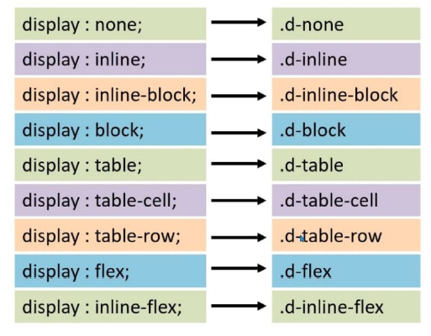
Display utilities
display

Slide 15
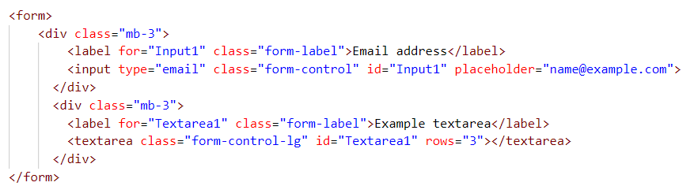
Form controls
It gives textual form controls like <input>s and <textarea>s an upgrade with custom styles, sizing, focus states, and more.

Slide 16
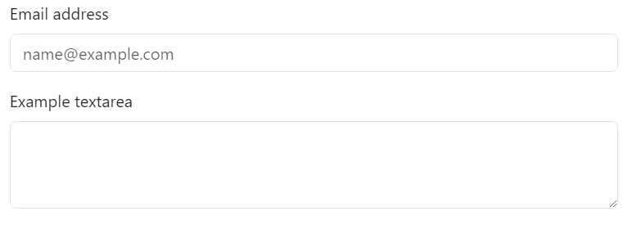
Form control output
Form control

Slide 17
Advantages of using Bootstrap
Responsive Design: Bootstrap is a mobile-first framework..
Consistency: Bootstrap comes with a consistent set of styles and components.
Cross-Browser Compatibility: Bootstrap is designed to work seamlessly across platforms and browsers..
Time-Saving: Bootstrap provides a wide range of pre-built components and templates thus, saves our time.
Community Support: Bootstrap is an open-source framework with a large community of developers and contributors, which means that there are plenty of resources available online, including documentation, forums, and tutorials.
Cost-Effective: Because Bootstrap is free and open-source, it can help reduce development costs and increase ROI.

Slide 18


